Slide 1
WEC Spring 2017
Silas Tsui, Allison Chan, Xiangyu Zhang, Nitish Bhatt

Slide 2
Problem Statement
The Elevator Problem presented in this case requires a complex algorithm which is optimized to deliver passengers to their locations with the minimum total travel time.
In this case, there are 2 distinct challenges:
Conducting decisions of when people should be picked up
Simulating elevator motion and correct time-dependent behaviour

Slide 3
Design Alternatives
We considered 2 major design alternatives in this case
Pick up strictly in current line of motion: Elevator will only pick up people in the line of motion (i.e. if elevator is moving up, it will only pick up people above the elevator who want to go up).
Pick up in either direction: Elevator will pick up people even if they don’t necessarily fall along its line of motion (i.e. if elevator is moving up then it may still consider picking up people below it)

Slide 4
Design Decisions
 | Minimize total waiting time for all waiting people | Handle multiple elevators effectively | Simulate elevator motion accurately
Design Alternative 1 | 2 | 1 | 1
Design Alternative 2 | 1 | 1 | 1

Slide 5
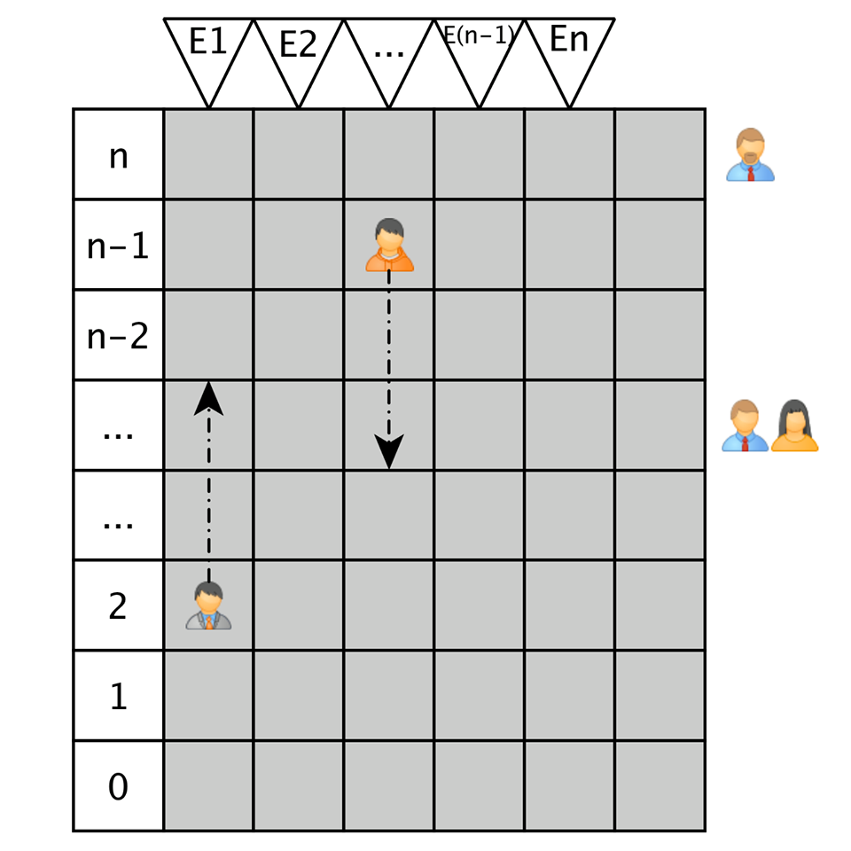
Summary of Variables
Major Parameters:
Number of floors
Number of Elevators
Major Variables
Time each individual waits
Elevator directions
Elevator floor
Target location of elevator

Slide 6
Decision Algorithm
Global Delegation
Find elevators travelling in same direction as waiting people
Local Decision
Decide at each second if each of the waiting people can be picked up without penalty
Computation
Calculate the effect of picking up person upon overall wait times for all people in system.

Slide 7
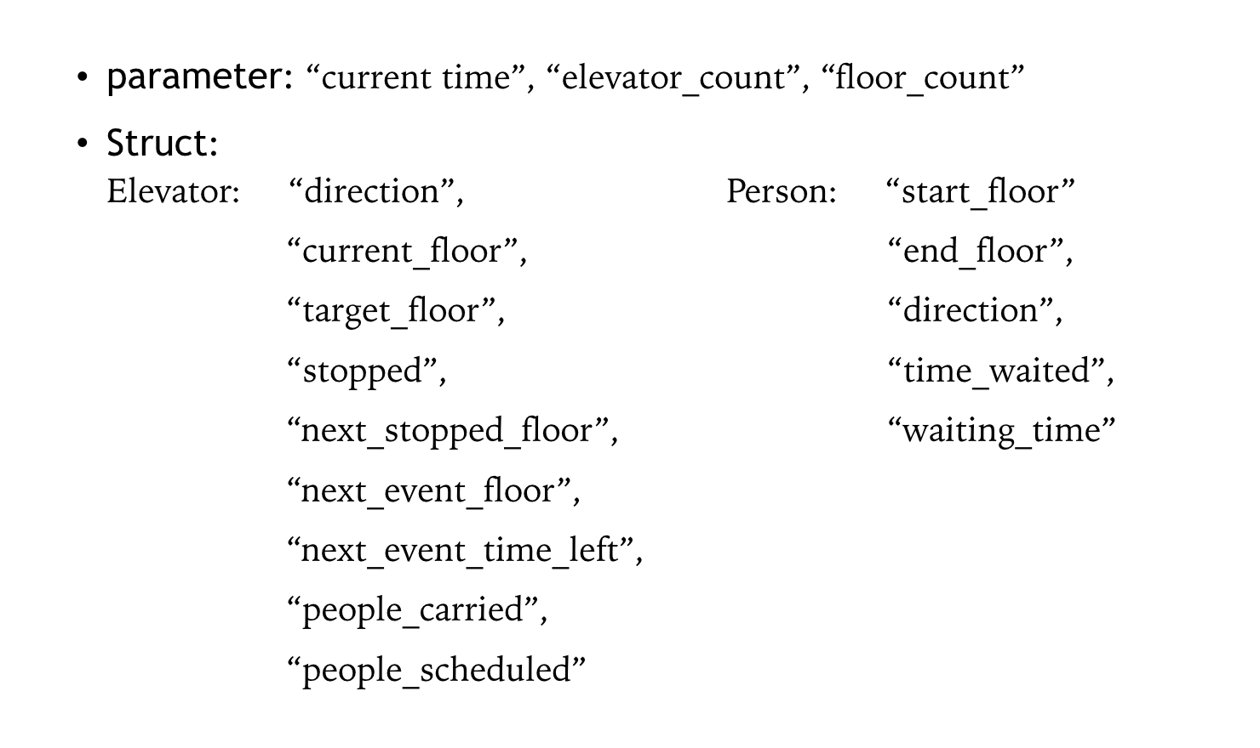
Implementation Details

